Slide 1
UNIT-III
StringHandling: String, StringBuffer and StringBuilder
Java.lang: Type Wrapper, Process, Runtime, Object class, Generics
IO:Java I/O Classes and Interfaces, Files and Directories, Byte and Character Streams
Serialization.

Slide 2
String
It is a sequence of characters. In java, objects of String are immutable which means a constant and cannot be changed once created.
The easiest way to represent a sequence of characters in Java is by using a character array.
In Java Strings are class objects and implemented using two classes
String
StringBuffer

Slide 3
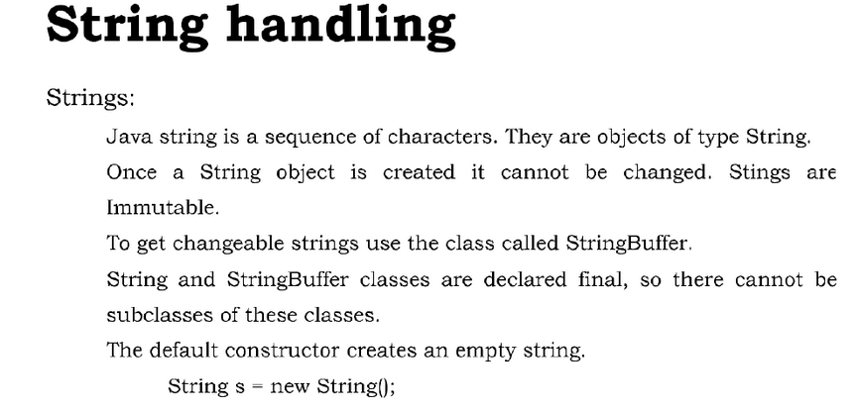

Slide 4
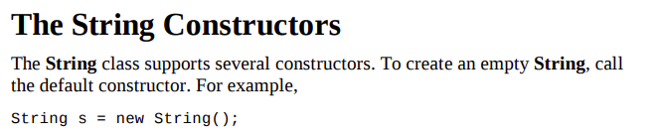




Slide 5
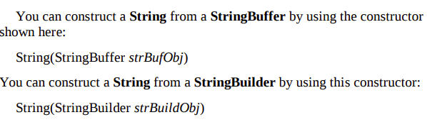

Slide 6
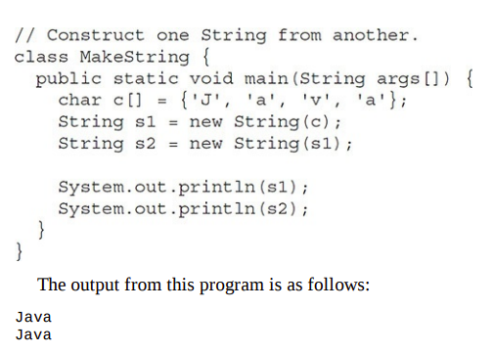

Slide 7
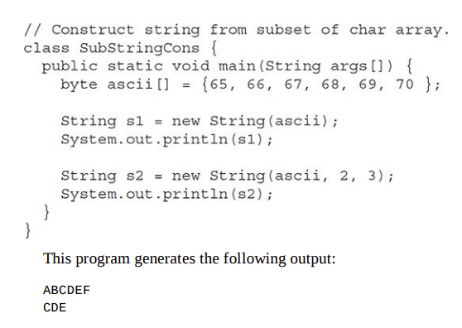

Slide 8
Ways of Creating a String
There are two ways to create a string in Java:
String Literal
Using new Keyword
Java defines one operator for String objects: +.
It is used to concatenate two strings. For example, this statement
String myString = "I" + " like " + "Java.";
results in myString containing
"I like Java."

Slide 9

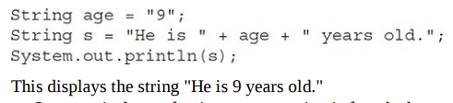

Slide 10

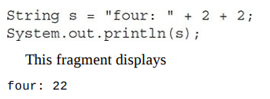


Slide 11
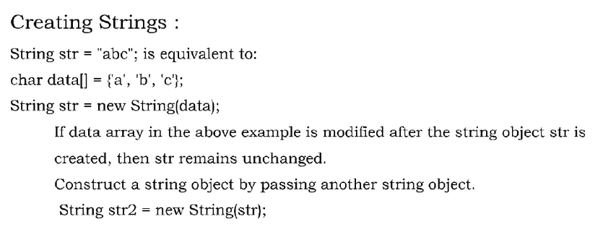

Slide 12
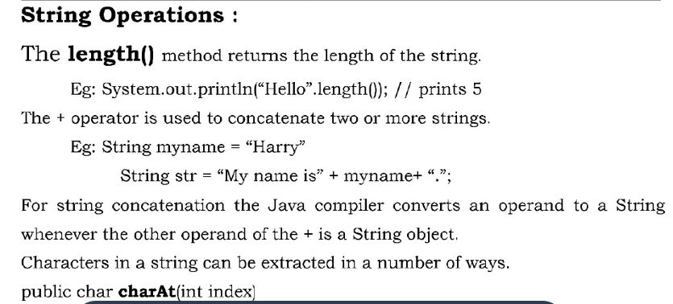

Slide 13
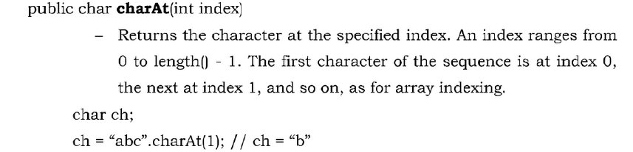

Slide 14
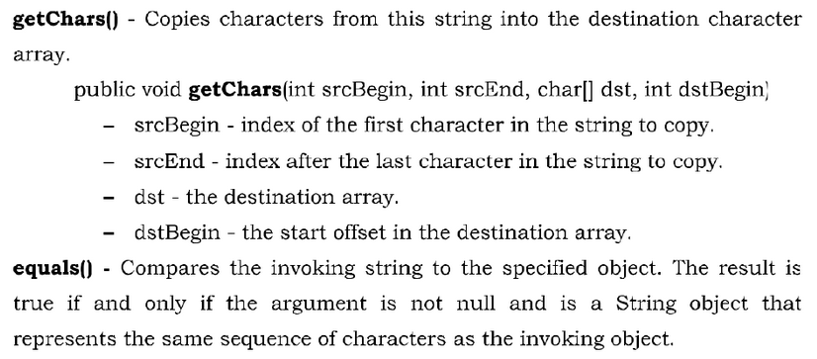

Slide 15
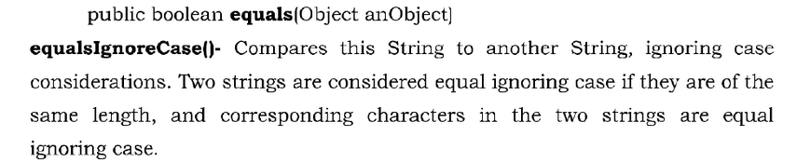
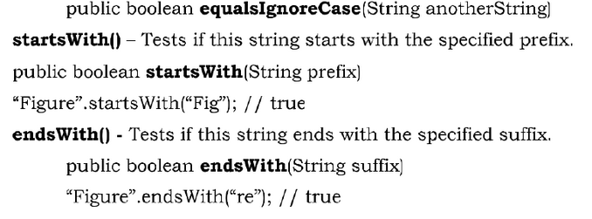

Slide 16
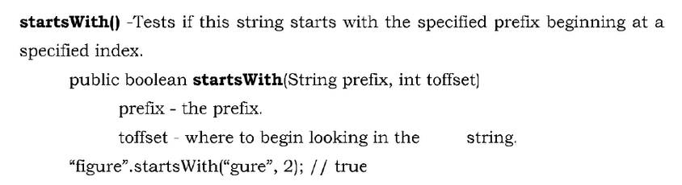

Slide 17
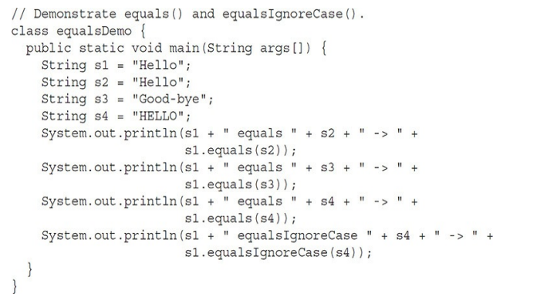

Slide 18
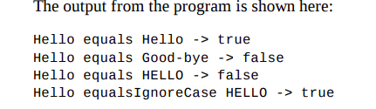

Slide 19
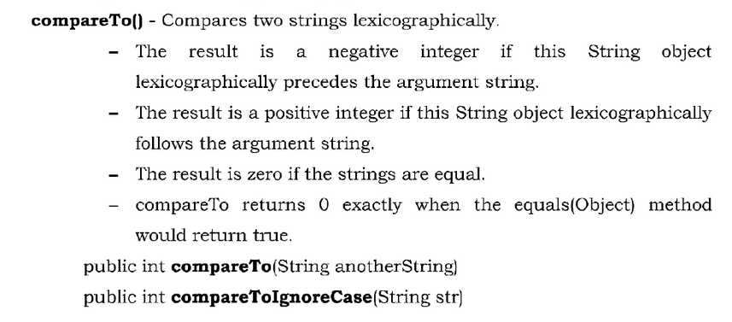

Slide 20
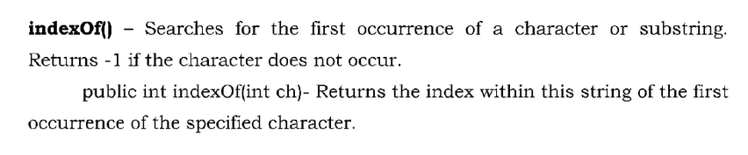
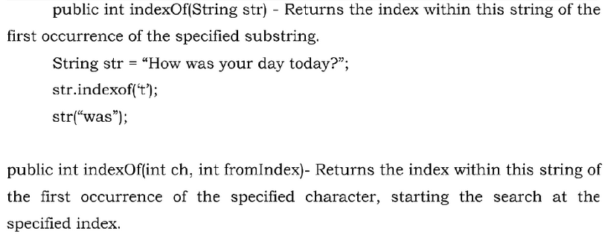

Slide 21
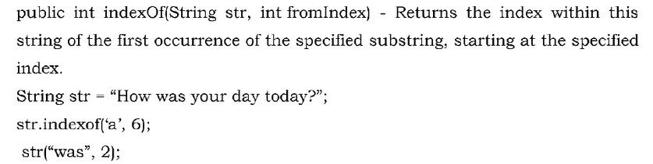

Slide 22
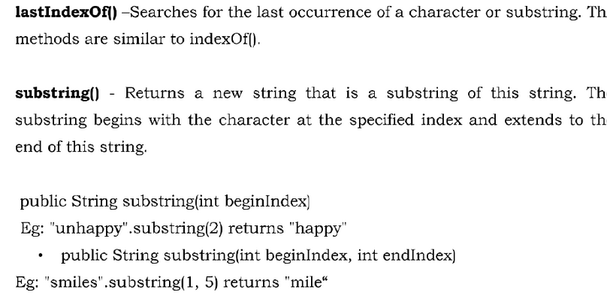

Slide 23
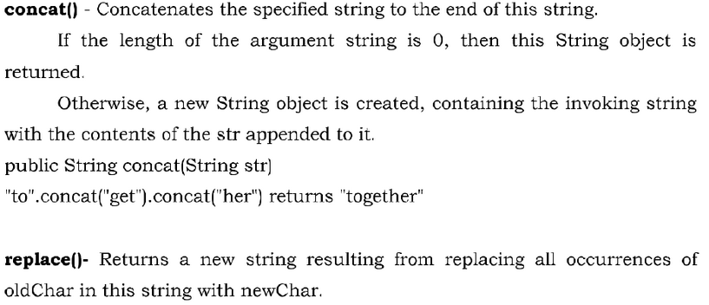

Slide 24
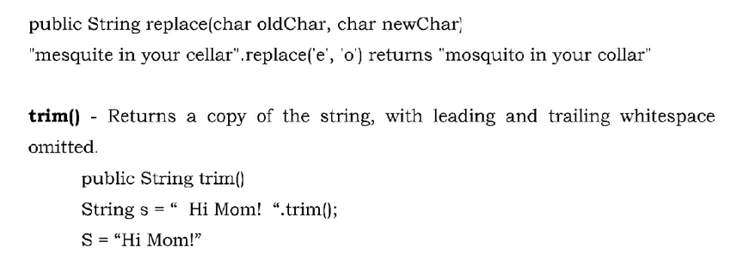

Slide 25
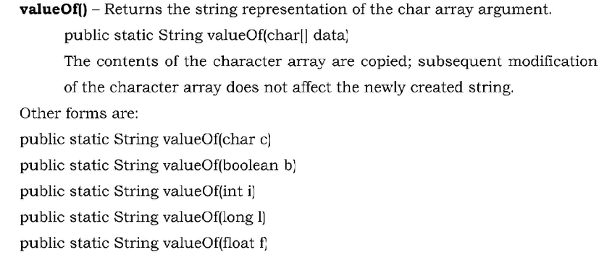

Slide 26
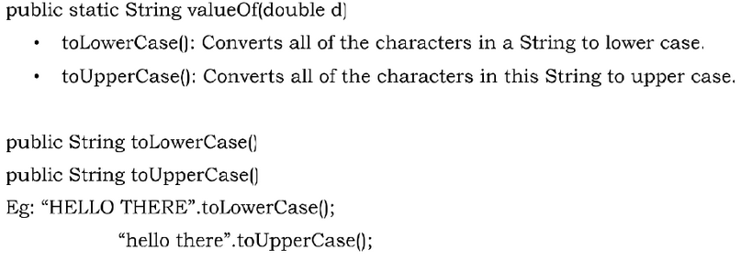

Slide 27
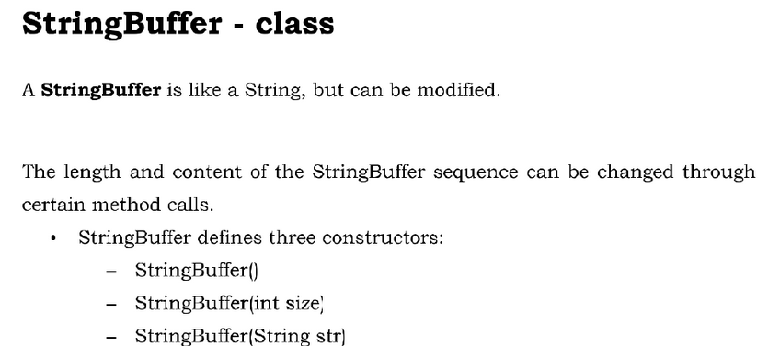

Slide 28
Java StringBuffer class is used to create mutable (modifiable) String objects.
The StringBuffer class in Java is the same as String class except it is mutable i.e. it can be changed.
StringBuffer class creates strings of flexible length that can be modified in terms of both length and content.
StringBuffer may have characters and substrings inserted in the middle or appended to the end.
StringBuffer automatically grows to make room for such additions

Slide 29
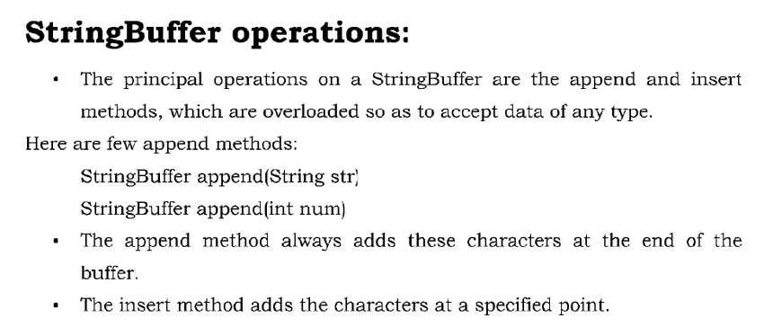

Slide 30
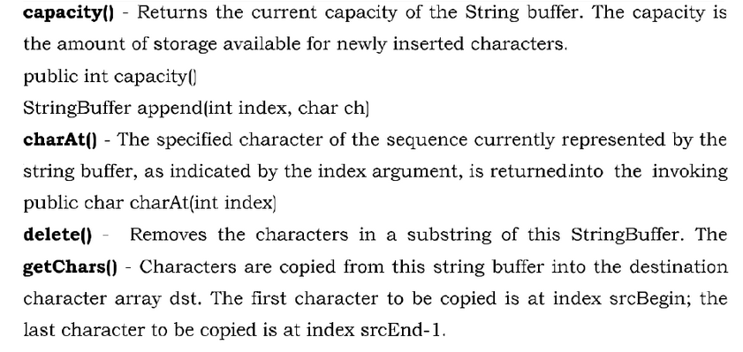

Slide 31
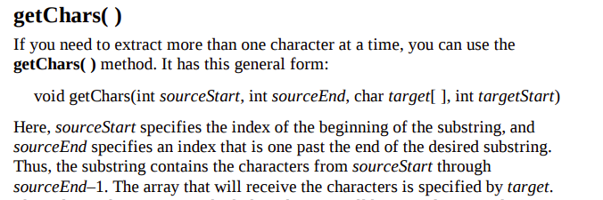

Slide 32
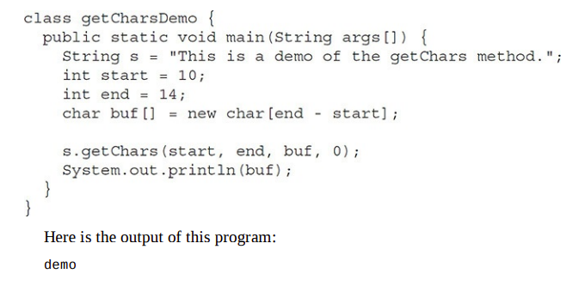

Slide 33
Sno | Method | Description
1 | char charAt(int index) | It returns char value for the particular index
2 | int length() | It returns string length
3 | static String format(String format, Object... args) | It returns a formatted string.
4 | String substring(int beginIndex) | It returns substring for given begin index.
5 | String substring(int beginIndex, int endIndex) | It returns substring for given begin index and end index.
6 | boolean contains(CharSequence s) | It returns true or false after matching the sequence of char value.
7 | static String join(CharSequence delimiter, CharSequence... elements) | It returns a joined string.
8 | static String join(CharSequence delimiter, Iterable<? extends CharSequence> elements) | It returns a joined string.

Slide 34
9 | boolean equals(Object another) | It checks the equality of string with the given object.
10 | boolean isEmpty() | It checks if string is empty.
11 | String concat(String str) | It concatenates the specified string.
12 | String replace(char old, char new) | It replaces all occurrences of the specified char value.
13 | String replace(CharSequence old, CharSequence new) | It replaces all occurrences of the specified CharSequence.
14 | static String equalsIgnoreCase(String another) | It compares another string. It doesn't check case.
15 | int indexOf(int ch) | It returns the specified char value index.
16 | int indexOf(int ch, int fromIndex) | It returns the specified char value index starting with given index.

Slide 35
17 | int indexOf(String substring) | It returns the specified substring index.
18 | int indexOf(String substring, int fromIndex) | It returns the specified substring index starting with given index.
19 | String toLowerCase() | It returns a string in lowercase.
20 | String toUpperCase() | It returns a string in uppercase.
21 | String trim() | It removes beginning and ending spaces of this string.
22 | static String valueOf(int value) | It converts given type into string. It is an overloaded method.

Slide 36
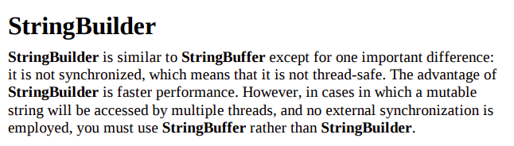

Slide 37
Constructors of StringBuilder
Constructor | Description
StringBuilder() | It creates an empty String Builder with the initial capacity of 16.
StringBuilder(String str) | It creates a String Builder with the specified string.
StringBuilder(int length) | It creates an empty String Builder with the specified capacity as length.

Slide 38
Sno. | String | StringBuffer
1) | The String class is immutable. | The StringBuffer class is mutable.
2) | String is slow and consumes more memory when we concatenate too many strings because every time it creates new instance. | StringBuffer is fast and consumes less memory when we concatenate t strings.
3) | String class overrides the equals() method of Object class. So you can compare the contents of two strings by equals() method. | StringBuffer class doesn't override the equals() method of Object class.
4) | String class is slower while performing concatenation operation. | StringBuffer class is faster while performing concatenation operation.
5) | String class uses String constant pool. | StringBuffer uses Heap memory

Slide 39
No. | StringBuffer | StringBuilder
1) | StringBuffer is synchronized i.e. thread safe. It means two threads can't call the methods of StringBuffer simultaneously. | StringBuilder is non-synchronized i.e. not thread safe. It means two threads can call the methods of StringBuilder simultaneously.
2) | StringBuffer is less efficient than StringBuilder. | StringBuilder is more efficient than StringBuffer.
3) | StringBuffer was introduced in Java 1.0 | StringBuilder was introduced in Java 1.5

